Slide 1
Office of Analytics
Minority Health Report 2023
Evelina Eytchison
2/14/2023

Slide 2
Minority Health Report
The goal is to highlight existing health disparities in Nevada by race/ethnicity and by region
Updated bi-annually
Data collected from several different sources: BRFSS, YRBS, Nevada Electronic Death Registry System, Nevada Central Cancer Registry, etc.
Significant findings are given for each section
Can be found under the Office of Analytics Data and Reports page.
Estimated to publish in early March 2023.

Slide 3
Key Findings, Overall
In 2021, COVID-19 was the leading cause of death for Asian/Pacific Islander-non-Hispanic, American Indian/Alaska Native-non-Hispanic, and Hispanic populations.
Death rates from diabetes were highest among Black-non-Hispanic population, at 44.8 per 100,000 population, compared to all other races/ethnicity groups.
Black-non-Hispanic population had significantly higher death rates from homicide for each year from 2017 to 2021 than any other race/ethnicity group.
A significantly larger portion of the bisexual population had thoughts of suicide and depression (15.4% and 52.2%, respectively) compared to the straight (3.6% and 14.9%, respectively) and gay/lesbian populations (1.4% and 20.8%, respectively).
Hispanic population had a higher prevalence than any other race group of not being able to afford healthcare (20.6%).
Notes:
Bla

Slide 4
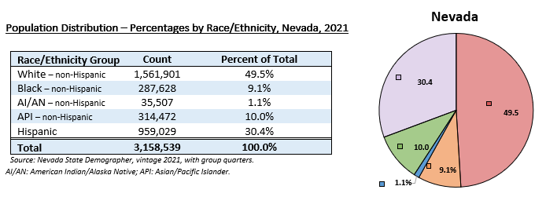
Nevada’s Population
Between the years 2020 and 2021, Nevada’s population decreased by 0.8% for a total population of 3,158,539 in 2021. Nevada’s population is comprised of a white majority, with the rest of the population comprising 30.4% Hispanic, 10.0% Asian/Pacific Islander, 9.1% Black, and 1.1% American Indian/Alaska Native.

Slide 5
Mortality
In 2021, in Nevada, the leading cause of death among all races and origins was classified as diseases of the heart with a death rate of 211.7 per 100,000 population.

Slide 6
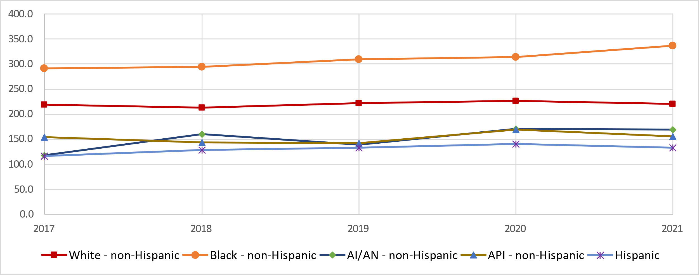
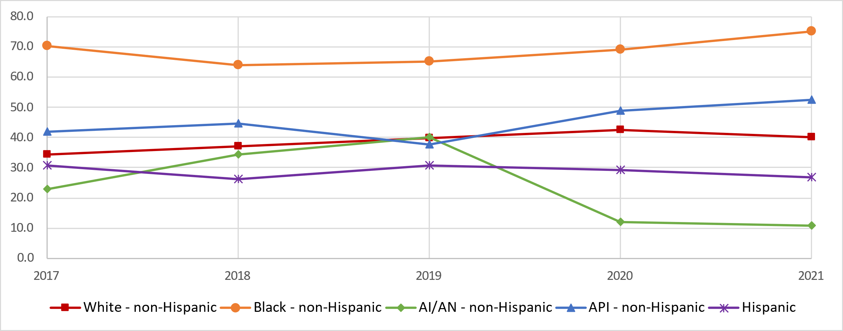
Mortality
Heart Disease Mortality – Counts and Age-Adjusted Death Rates by Race/Ethnicity and Year, 2017 – 2021
In 2021, Black-non-Hispanic population had significantly higher death rates for Heart disease and strokes (337.5 and 75.0 respectively).
Stroke Mortality – Counts and Age-Adjusted Death Rates by Race/Ethnicity and Year, 2017 – 2021

Slide 7
Cancer
Cancer is the second leading cause of death in Nevada and the United States. Cancer is typically diagnosed late in life with 80.8% of cases diagnosed in Nevada among those ages 55 years and older. Cancer deaths among those younger than 45 years of age is considered especially burdensome on social and economic aspects of society due to the loss of productive years of life.
Figure 29. Early vs Late Deaths* – Percent of Total Deaths, Nevada, and United States, 2019

Slide 8
Unintentional Injuries
In 2021, White non-Hispanic, Black-non-Hispanic, and American Indian/Alaska Native non-Hispanic populations had significantly higher accidental death rates (70.8, 94.0, and 82.6 per 100,000 population, respectively) than Asian/Pacific Islander-non-Hispanic population (27.9 per 100,000), and Hispanic populations (39.1 per 100,000) (Figure 39).
Figure 39. Accidental Deaths – Age-Adjusted Rates by Race/Ethnicity and Year, Nevada Residents, 2017-2021

Slide 9
Chronic Lower Respiratory Disease
Figure 44. Chronic Lower Respiratory Disease Mortality – Age-Adjusted Rates by Race/Ethnicity and Year, 2017-2021
Figure 46. Nevada Adults Who Have Been Told They Have Asthma – Prevalence by Race/Ethnicity, 2021

Slide 10
Diabetes
Figure 48. Diabetes Mortality – Age-Adjusted Rates by Race/Ethnicity and Year, 2017-2021
Figure 50. Adults Who Have Been Told They Have Diabetes – Prevalence by Race/Ethnicity, Nevada, 2021

Slide 11
Homicide and Suicide
Figure 52. Homicide– Age-Adjusted Rates by Race/Ethnicity and Year, 2017-2021
Figure 54. Suicide– Age-Adjusted Rates by Race/Ethnicity and Year, 2017-2021

Slide 12
Influenza and Pneumonia
Figure 58. Influenza and Pneumonia Mortality – Age-Adjusted Rates by Race/Ethnicity and Year, 2017-2021
Figure 60. Adults who Received the Flu Shot Within the Past 12 Months – Prevalence by Race/Ethnicity, Nevada, 2021

Slide 13
HIV/AIDS
Black-non-Hispanic population had significantly higher rates of reported cases of HIV infection than every other race/ethnicity group for each year from 2017 to 2021.
Figure 62. New HIV Infections – Crude Rates by Race/Ethnicity and Year, Males and Females, Nevada Residents, 2017-2021

Slide 14
Maternal and Infant Health
Figure 71. Overall Birth Rates by Race/Ethnicity and Year, Nevada, 2017-2021
Figure 73. Teen Birth Rates by Race/Ethnicity and Year, Nevada, 2017-2021

Slide 15
Mental Health
Figure 82. Nevada Adults Who Reported 14-30 Days of Poor Mental Health in the Last Month - Prevalence by Race/Ethnicity, Nevada, 2021
Figure 84. Nevada Adults Who Reported Difficulty Concentrating, Remembering, or Making Decisions because of a Physical, Mental, or Emotional Condition - Prevalence by Race/Ethnicity, Nevada, 2021

Slide 16
Communicable Diseases
Figure 88. Enteric* Disease Morbidity – Age-Adjusted Rates by Race/Ethnicity and Year, 2017-2021
Figure 92. Vaccine Preventable* Disease Morbidity – Age-Adjusted Rates by Race/Ethnicity and Year, 2017-2021
Notes:
*Vaccine preventable disease includes: haemophilus influenzae, hepatitis B (acute), hepatitis B virus infection perinatal, hepatitis C, hepatitis delta, invasive pneumococcal disease, measles, meningococcal disease, mumps, pertussis, tetanus, varicella.
*Respiratory disease includes: coccidioidomycosis, legionellosis, psittacosis, tuberculosis.

Slide 17
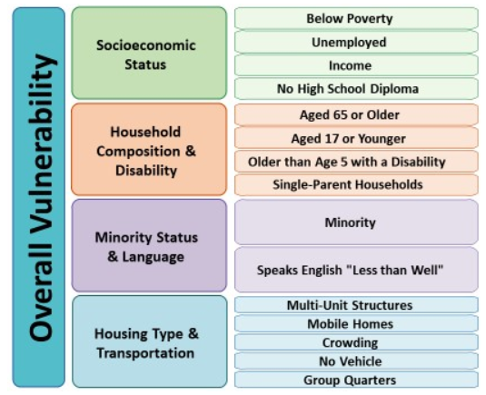
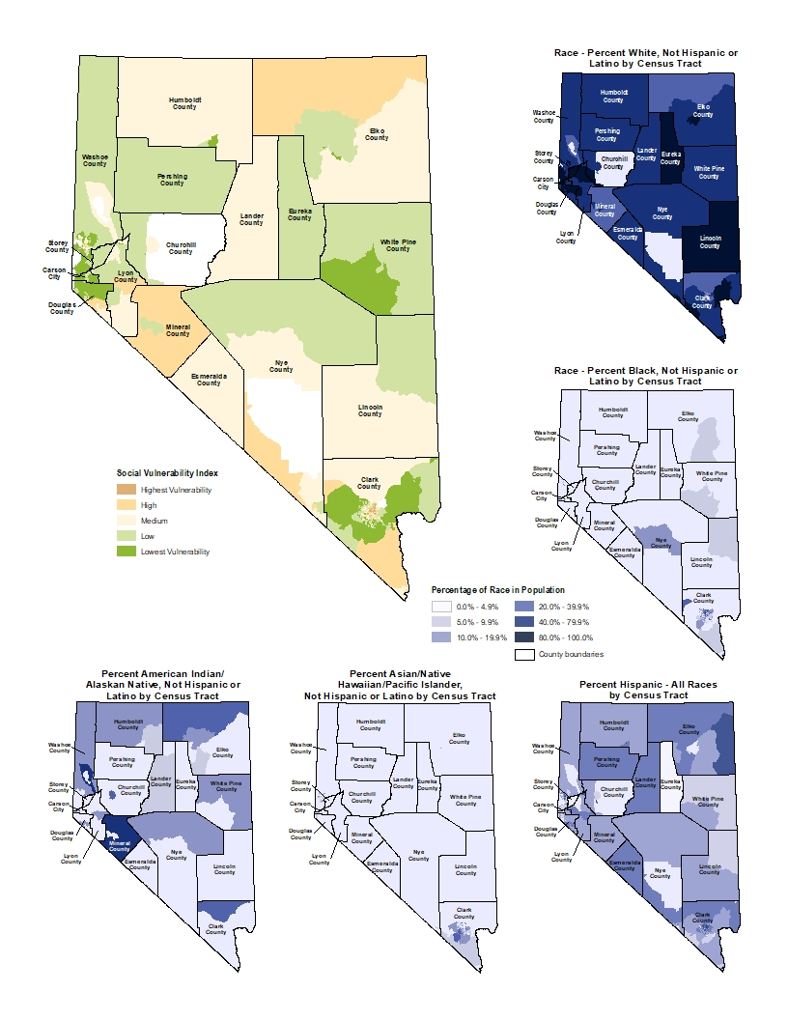
Vulnerability and Health Equity
Figure 108. Overall Vulnerability by Census Tract, 2020
The overall vulnerability of a community is determined by the level of vulnerability of a community for each of the previous indicators – socioeconomic status, household composition, minority status and language, and housing type and transportation. Overall, Nye County has the highest area of census tracts with the lowest vulnerability and Mineral County has the highest area of census tracts with the highest vulnerability.

Slide 18
Sexual Orientation and Gender Identity
Population Distribution
In Nevada, majority of the population is straight (93.9%), 4.2% are bisexual, and 1.9% are gay/lesbian, based on the Nevada Behavioral Risk Factor Surveillance.
Figure 117: Population Distribution – Percentages by Sexual Orientation and Gender Identity, Nevada, 2021
Figure 123: Prevalence of Thoughts of Suicide by Sexual Orientation, Nevada, 2021

Slide 19
New Sections Added
Access to Health Care
Maternal Mortality and Severe Maternal Morbidity
Figure 81. Pregnancy-Associated Death (Maternal Mortality) and Severe Maternal Morbidity Ratios, Nevada, 2020-2021
Figure 12. Couldn’t Afford to See a Doctor Last Year – Prevalence by Race/Ethnicity, Nevada, 2021

Slide 20
New Sections (cont.)
COVID-19
Figure 94. COVID-19 Cases - by Race/Ethnicity and Region, Nevada Residents, 2021
Figure 95. COVID-19 Mortality by Race/Ethnicity and Region, Nevada Residents, 2021

Slide 21
New Sections (cont.)
Drug Poisonings
Figure 96. Emergency Department Non-Fatal Opioid Poisoning Rates by Race/Ethnicity and Year, Nevada, 2017-2021
Juvenile Arrests and Detentions
Figure 114: Arrest Counts by Region, and by Race/Ethnicity, Nevada, 2021

Slide 22
Questions?

Slide 23
Contact Information
Evelina Eytchison
Biostatistician II
eeytchison@dhhs.nv.gov
Data and information compiled by the Department of Health and Human Services, Office of Analytics. DHHS.nv.gov/analytics

