Slide 1

Endorsement | 101

Slide 2

NV-AIECMH
A Multidisciplinary Non-Profit Organization For All Professionals Who Support The Development Of Children Birth Up To Age 6.

Slide 3
Why Infants and Young Children?
Brain Development
&
Relationships

Slide 4

Why Infants and Young Children?

Slide 5
IECMH-E©
The Infant and Early Childhood Mental Health Endorsements are a verifiable process that recognizes the knowledge and training among professionals across disciplines within an organized system of culturally informed, relationship-focused learning and work experiences that promote infant and early childhood mental health.

Slide 6
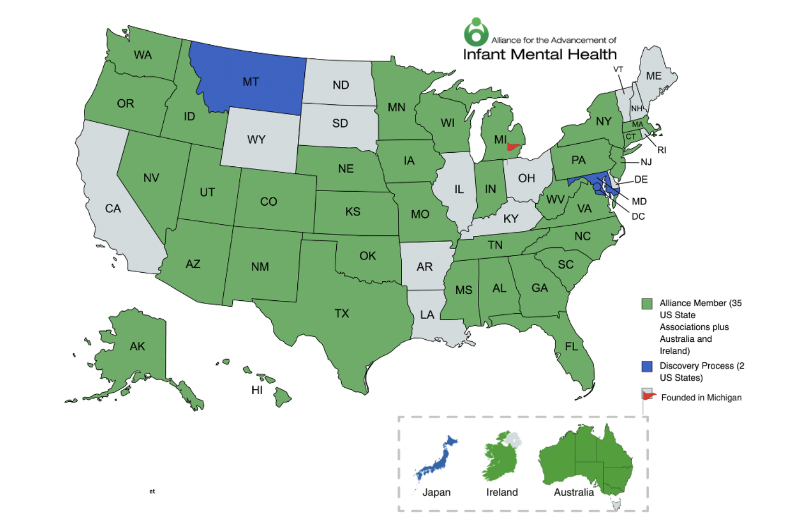
IECMH-E©

Slide 7
Infant vs Early Childhood Endorsement
Early Childhood Mental Health (ECMH-E®)
Specializing in work experience with 3-6 year-olds & their families
Infant Mental Health
(IMH-E®)
Specializing in work experience with 0-3 year-olds & their families
Notes:
IMH-E® shows that professionals have attained specific work experience and expertise with prenatal up to 3-year-olds and their families.
ECMH-E® shows that professionals have attained specific work experience and expertise with 3-6-year-olds and their families.

Slide 8
Pathways to Endorsement
Promotion
Infant/Early Childhood Family Associate
Prevention
Infant/Early Childhood Family Specialist
Infant/Early Childhood Family Reflective Supervisor
Clinical Intervention
Infant/Early Childhood Mental Health Specialist
Leadership
Infant/Early Childhood Mental Health Mentor

Slide 9
Endorsement Category Requirements
Notes:
1 Family Associate applicants need to meet the Education OR the Work requirement they do not need to meet both.
2 For Family Associate applicants, volunteer experience may meet the work criterion if it was a) supervised experience with women during pregnancy or with infants, toddlers, & families AND b) included specialized training. Examples include CASA, Doula, Child Life Specialist.

Slide 10
Why Endorsement?
It’s good for the Professional
It’s good for Children and Families
It’s good for the Community
It’s good for Employers

Slide 11
Where to Begin
Become an Association Member
Join us for our
Endorsement Kickoff
in locations across the State
in January

Slide 12
Connect
With
Us!
• Join our Email List •
• Apply for Membership •
• RSVP for the Endorsement Kickoff •
Jacquelyn Kleinedler, MA, MFT
Executive Director
jkleinedler@nvaiecmh.org
775-682-1316
info@nvaiecmh.org

